Slide 1
DB Programming RED Team Phase 1 – Analyze, design, Build an operational database
Akshay Jadhav
Jaymeen Gandhi
Tejas Joshi
Anmol Kansara
Rashmi Jain
Mayuri Khade

Slide 2
Agenda Mayuri Khade
Project Description
Project Requirements
Individual Attribute Analysis
Entity Relationship (ER) Diagram
SQL Queries to create tables
Group Summary
Conclusion
Recommendation

Slide 3
Project Description Mayuri Khade
In the entire system, there are some pre-defined access rules for individual roles in Access Rules table.
There is a developed machine learning model which was designed to predict the legitimate access by comparing with predefined access rules for individual roles with the help of dependent (predicted) variable called ‘Score’.
However, access rules violation(known as discrepancy) is happening even after building an efficient ML Model among legitimate roles having Score True.
We are gathering evidence against such discrepancies happening among the legitimate roles.
We should keep the record of these discrepancies happened, so that we would be able to improve the performance of whole system as well as we can adjust the model parameters to make the model more efficient.

Slide 4
Project Requirements Mayuri Khade
To create a schema called “SYNC” which would explore the relationships between different entities which would be essential in the project.
To design an ER Model for defining entities such as Access Rules, Model, and Discrepancy, define the attributes, and define the relationships between entities by using attributes.
To convert logical ER Model into physical model by converting entities into tables and attributes into columns using SQL to make a best operational and relational database.

Slide 5
Individual Attribute Analysis. Akshay Jadhav
Model & Discrepancy Table - Score → Akshay Jadhav
Access Rules, Model & Discrepancy table – Time → Jaymeen Gandhi
Model & Discrepancy Table – Violation Type → Tejas Joshi
Access Rules, Model & Discrepancy table – Role → Anmol Kansara
Access Rules, Model & Discrepancy table – Request Type → Rashmi Jain
Access Rules, Model & Discrepancy table – Component → Mayuri Khade

Slide 6
Score Attribute Akshay Jadhav
Model table
Score attribute is a dependent variable which could be used for prediction depending on all other attributes (independent variables).
Based on prediction of True or False, model could provide legitimate differentiation between authorized and unauthorized roles based on defined access rules.
Due to poor performance of a model, some authorized roles with true score flag found out suspicious and discrepancies are happening by violating access rules previously defined.
Score will play a vital role in Model table to further investigate the evidence against the discrepancies happened.

Slide 7
Score Attribute Akshay Jadhav
Score attribute has following characteristics in Model table:
Data Type: VARCHAR
Size of Data Type: 5
Bytes used (in memory): (Length of characters + 1)
Indexing: Not required
Constraints: Not required

Slide 8
Score Attribute Akshay Jadhav
Discrepancy Table
Score attribute in discrepancy table used in conjunction with all evidences about discrepancies which were analyzed among only the authorized roles.
Score attribute is having following characteristics in Discrepancy table:
Data Type: VARCHAR
Size of Data Type: 5
Bytes used (in memory): (Length of characters + 1)
Indexing: Not required
Constraints: Not required

Slide 9
Time Attribute Jaymeen Gandhi
Access rule table
The start time and end time attributes in the access rule table is a defined time frame in which role would be able to access the component with specific request type.
Time attribute is having following characteristics in Access Rule table:
Data Type: DATETIME
Fomat: Date: mm/dd/yy Time : hh:mm:ss
Bytes used (in memory): 8
Indexing: Not required
Constraints: Not required

Slide 10
Time Attribute Jaymeen Gandhi
Model table
The time attribute in the model table is an independent attribute which provides exact time for access of components by different roles.
Discrepancy occurrence also depends on the time at which the role is accessing a component.
Time should fall in between the defined start time and end time attributes in the access rule table for individual role.
Discrepancy table
Time attribute provides the time at which predicted legitimate but unauthorized role violate the defined access rule.
Time attribute is having following characteristics in Model and Discrepancy tables:
Data Type: DATETIME
Fomat: Date: mm/dd/yy Time : hh:mm:ss
Bytes used (in memory): 8
Indexing: Not required
Constraints: Not required

Slide 11
Violation Type Attribute Tejas Joshi
Model and Discrepancy table
Violation type attribute in Model table indicates the type of violation, roles have been performed to access data out of their scope.
Violation type in Discrepancy table indicates the type of violation that predicted legitimate roles have been performed who were founded as evidence against discrepancies happened.
Violations therefore regarded as cause for disciplinary action.
Examples of violation Type are: No Authorization, Neglect of duty, Non-Normal Time, Misconduct, etc.
Violation Type has following characteristics in Model and Discrepancy table:
Data Type: VARCHAR
Size of Data Type: 20
Bytes used (in memory): (Length of characters + 1)
Indexing: Required
Constraints: Not required

Slide 12
Role Attribute Anmol Kansara
Model table
The role attribute in model table is used to classify between authorized and unauthorized roles with the help of predicting flag Score. And to validate the user authorization we need to do comparison.
For authorized user the Time, Component, Request_type and role attritubes should have exact match between the Model and Access rule table attributes. If valid role then the set Score to True otherwise False.
Access Rules table
The role is an attribute for which there are certain access rules defined in the Access Rules table.

Slide 13
Role Attribute Anmol Kansara
Discrepancy table
With the help of discrepancy table we will get to know how many predicted authorized by a model, but actual unauthorized roles have accessed the components.
Also, if any data breach has happened during a particular interval, what security actions need to be taken about the components, how the database would be more secure and reliable.
Role attribute has following characteristics in Model table, Access Rule table and Discrepancy table:
Data Type: VARCHAR
Size of Data Type: 15
Bytes used (in memory): (Length of characters + 1)
Indexing: Required
Constraints: Not required

Slide 14
Request Type Attribute Rashmi Jain
Request Type is an attribute which connects the database using operations such as select, append etc. on the database.
Access rules and Model tables determines what request can be made to the database as per the roles.
In the Discrepancies table, request type would indicate which queries such as select, append, etc. have been used by unauthorized roles while doing violation.
Request Type attribute has following characteristics in Model table:
Data Type: VARCHAR
Size of Data Type: 10
Bytes used (in memory): (Length of characters + 1)
Indexing: Required
Constraints: Not required

Slide 15
Component Attribute Mayuri Khade
Component attribute is having following characteristics in below tables:
Data Type: VARCHAR
Size of Data Type: 10
Bytes used (in memory): (Length of characters + 1)
Indexing: Required
Constraints: Not required
Access rule table
Component attribute is an independent variable, which provides the information of the records component type i.e. which component is used. ex: Element, Table, Node, Cluster, etc.
Model table
Component attribute is an independent variable, which provides the information of the records component type i.e which component is used. ex: Element, Table, Node, Cluster, etc.
Discrepancy table
Component attribute in discrepancy table used in conjunction with all evidences about discrepancies which were analyzed among only the authorized roles.

Slide 16
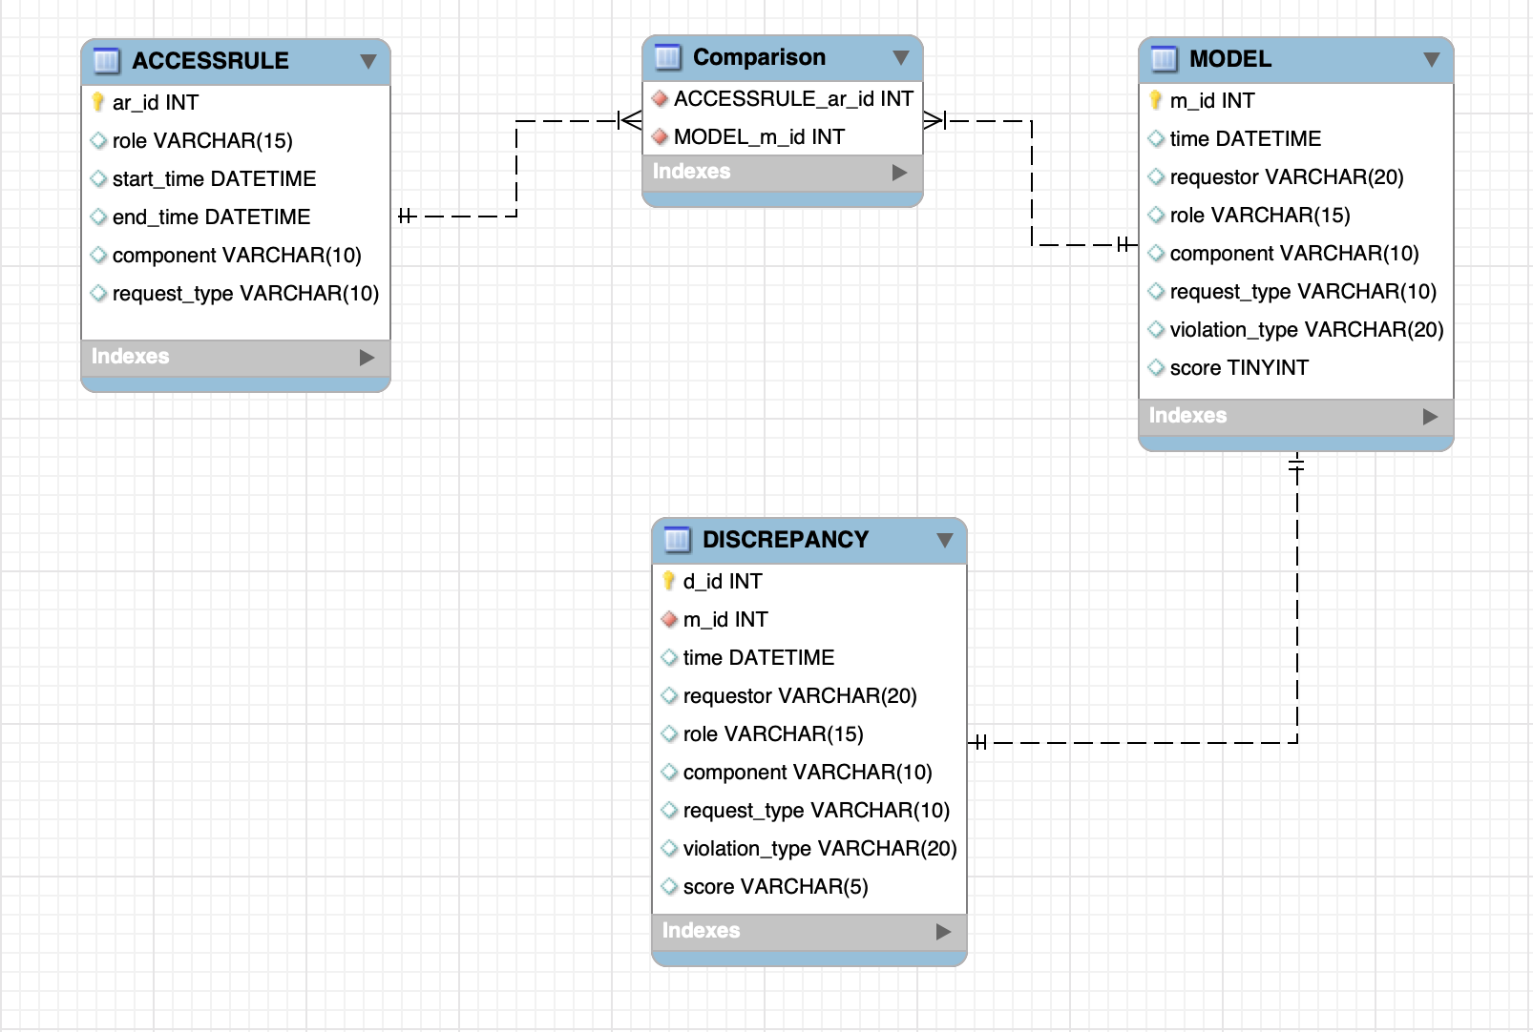
Entity Relationship Diagram Tejas Joshi

Slide 17
SQL Queries to create tables Rashmi Jain
Model Table
CREATE TABLE IF NOT EXISTS `sync`.`MODEL` (`m_id` INT NOT NULL AUTO_INCREMENT,
`time` DATETIME NULL,
`requestor` VARCHAR(20) NULL,
`role` VARCHAR(15) NULL,
`component` VARCHAR(10) NULL,
`request_type` VARCHAR(10) NULL,
`violation_type` VARCHAR(20) NULL,
`score` VARCHAR(5) NULL,
PRIMARY KEY (`m_id`),
UNIQUE INDEX `m_id_UNIQUE` (`m_id` ASC) VISIBLE)
ENGINE = InnoDB;

Slide 18
SQL Queries to create tables Rashmi Jain
Access Rules Table
CREATE TABLE IF NOT EXISTS `sync`.`ACCESSRULE` (
`ar_id` INT NOT NULL AUTO_INCREMENT,
`role` VARCHAR(15) NULL,
`start_time` DATETIME NULL,
`end_time` DATETIME NULL,
`component` VARCHAR(10) NULL,
`request_type` VARCHAR(10) NULL,
PRIMARY KEY (`ar_id`),
UNIQUE INDEX `ar_id_UNIQUE` (`ar_id` ASC) VISIBLE)
ENGINE = InnoDB;

Slide 19
SQL Queries to create tables Anmol Kansara
Comparison Table
CREATE TABLE IF NOT EXISTS `sync`.`Comparison` (
`ACCESSRULE_ar_id` INT NOT NULL,
`MODEL_m_id` INT NOT NULL,
INDEX `fk_m_id_idx` (`MODEL_m_id` ASC) VISIBLE,
CONSTRAINT `fk_ar_id`
FOREIGN KEY (`ACCESSRULE_ar_id`)
REFERENCES `sync`.`ACCESSRULE` (`ar_id`)
ON DELETE CASCADE
ON UPDATE CASCADE,
CONSTRAINT `fk_m_id`
FOREIGN KEY (`MODEL_m_id`)
REFERENCES `sync`.`MODEL` (`m_id`)
ON DELETE CASCADE
ON UPDATE CASCADE)
ENGINE = InnoDB;

Slide 20
SQL Queries to create tables Anmol Kansara
Discrepancy Table
CREATE TABLE IF NOT EXISTS `sync`.`DISCREPANCY` (
`d_id` INT NOT NULL AUTO_INCREMENT,
`m_id` INT NULL,
`time` DATETIME NULL,
`requestor` VARCHAR(20) NULL,
`role` VARCHAR(15) NULL,
`component` VARCHAR(10) NULL,
`request_type` VARCHAR(10) NULL,
`violation_type` VARCHAR(20) NULL,
`score` VARCHAR(5) NULL,
PRIMARY KEY (`d_id`),
UNIQUE INDEX `d_id_UNIQUE` (`d_id` ASC) VISIBLE,
INDEX `m_id_idx` (`m_id` ASC) VISIBLE,
CONSTRAINT `m_id`
FOREIGN KEY (`m_id`)
REFERENCES `sync`.`MODEL` (`m_id`)
ON DELETE CASCADE
ON UPDATE CASCADE)
ENGINE = InnoDB;

Slide 21
Group Summary Jaymeen Gandhi
Analyzed the overall project idea and project requirements for the Phase 1.
Performed individual analysis on attributes to get more insights into the role of each attribute in each table.
Designed an ER Model to get the relationships between the entities such as Access Rules, Model, and Discrepancy.
Transformed ER Model to physical model by converting entities into tables and attributes into columns using SQL.
Designed an operational and relational database structure for the project.

Slide 22
Conclusion Akshay Jadhav
Based on evidence of discrepancy, we have to take the necessary strict actions against the predicted legitimate roles(i.e. actual unauthorized roles), who are trying to access the data out of their scope, which could be a major threat to the system by means of data breach.
Discrepancies are happening among the falsely predicted roles as legitimate roles by the model, so we have to revise and adjust the model parameters to improve the prediction performance of the model.
By considering unforeseen data breach, we have to revise and make more strict access rules for the most important data, to avoid major threat to the system.

Slide 23
Recommendation Akshay Jadhav
While gathering evidence against the discrepancies, instead of comparing all attributes in Access Rules table to equivalent attributes in Model table, we could compare by using IDs(surrogate key) of both Access Rules and Model table as well as Time attribute, to keep the design of database less complicated.

Slide 24
THANK YOU
Any Questions..???

